Slide 1
Software Engineering and Project Management Project:
EXPENSE TRACKER
TEAM:
NIKHITHA GEDDADA(RA1911032010038), ADITI SAHU(RA1911032010034)

Slide 2
Problem Statement
Expensify is a platform which can be exclusively used by anyone who wants to keep track of their expenses. It helps you stick to your budget and reveal spending issues. Keeping record here will be much easier than using pen and paper. Being a smart expense tracker, it is a voice-based application where you need to give instructions verbally and it will categorize according to it.
The main reason you should track your expenses is to identify and eliminate wasteful spending habits in your financial life. Moreover, consistently tracking your expenses will help you maintain control of your finances, and promote better financial habits like saving and investing.
It has a graphical description for income as well as expenses category giving users a clear and detailed analysis about the spending and budget.
Tech stack used here will be React , JavaScript , Some of the concepts are State Management in React, Context API, Local Storage, Material UI, and adding voice capabilities resulting in a scalable live application ready to be used on daily basis.

Slide 3
REQUIREMENTS
Functional Requirements:
Functional Requirements can also be expressed in the form of “user story” which is the smallest unit of work in an agile framework. It’s an end goal, not a feature, expressed from the software user’s perspective.
Requirement (#) | Requirement Specification | Department | Name of Business User | Status
E1FR1 | Voice converter api | Backend | User | Unknown
E1FR2 | Location Stamp | Software Development | User | Unknown
E1FR3 | Self-Productivity | Data Analytics | User | Unknown

Slide 4
REQUIREMENTS
Non-functional Requirements:
The information is refreshed depending upon whether some updates have occurred or not in the application. The system shall respond to the member in not less than two seconds from the time of the request submission.
The system is available 100% for the user and is used 24 hrs a day and 365 days a year. The system shall be operational 24 hours a day and 7 days a week.
Registration Service of new users should scale to serve 1000 request per second over 5 minutes timespan
All Student and faculty data shall be store within the organization to which they belong.
The system should accurately provide real time information taking into consideration various concurrency issues. The system shall provide 100% access reliability
The system has to be 100% reliable due to the importance of data and the damages that can be caused by incorrect or incomplete data.

Slide 5
HIGH LEVEL REQUIREMENTS
Requirements:
Registration –where users can create an account directly from the website and save all the information.
Group creation – information can be grouped into different categories.
Log expense –the user will enter all expense details in the application and module will calculate the dues.
The data will then be sync with the online service and update expense log in main database
Internet connection is required

Slide 6
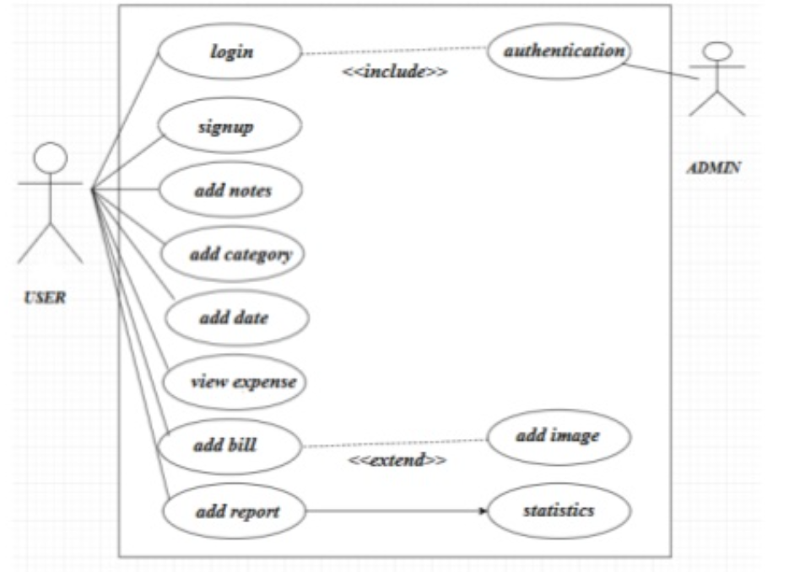
DESIGN
USE CASE DIAGRAM
There are two actors in this system i.e the user and the administrator. The user can add expenses, date, category, bills,reports and also view expenses. On the basis of these inputs our application will show the trends.
Used to gather the requirements of a system.
Used to get an outside view of a system.
Show the interaction among the requirements are actors.

Slide 7
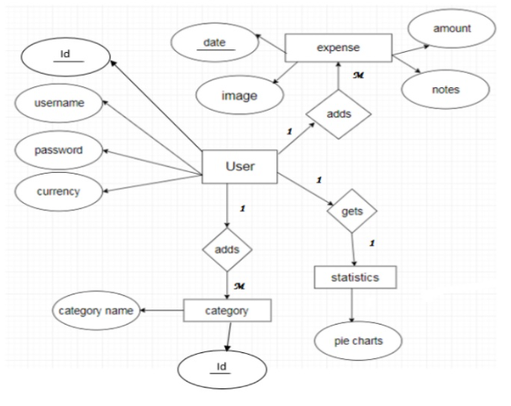
ENTITY RELATIONSHIP DIAGRAM (ER)
The diagram explains the relationship between the databases where rectangle represents entity, oval represents attributes and diamond represents relationships.There are four entities with their respective attributes.

Slide 8
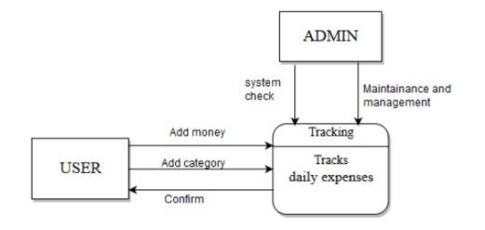
DATA FLOW DIAGRAM level 0
The user adds money to the tracking system, the system then updates it to our local database and then the database will retrieve it to the system. The data is then confirmed by the user.

Slide 9
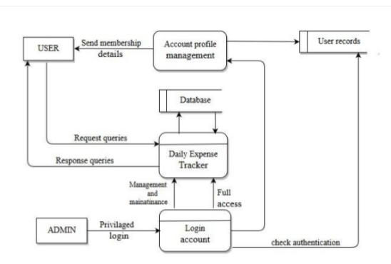
DFD LEVEL -1
Here we can track our data(expenses).

Slide 10
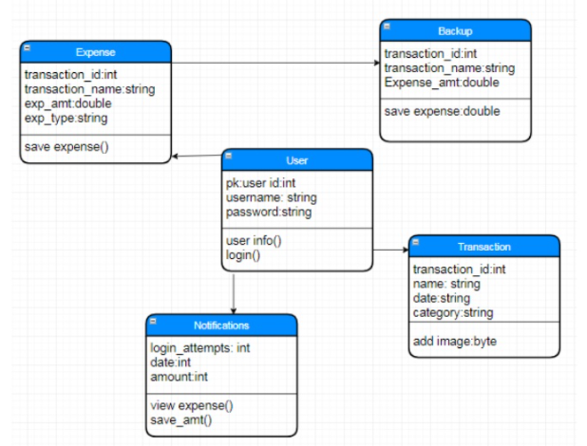
CLASS
DIAGRAM
Describes the static view of the system.
Shows the collaboration among the elements of the static view.
Describes the functionalities performed by the system.
Construction of software applications using object oriented languages.

Slide 11
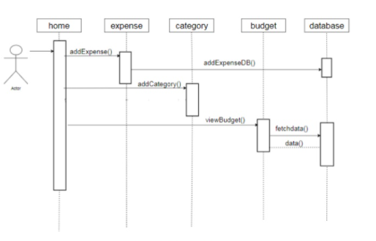
SEQUENCE
DIAGRAM
The lifelines here are home, expense, category, budget and database.
Purpose:
To model high-level interaction among active objects within a system.
To model interaction among objects inside a collaboration realizing a use case.
It either models generic interactions or some certain instances of interaction.

Slide 12
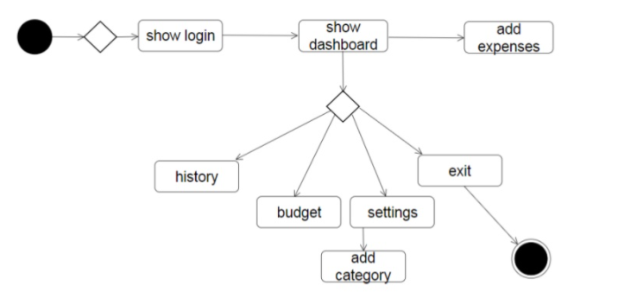
STATECHART DIAGRAM
When the user visits the site, we transit from the initial state to login state.The user dashboard appears which shows history, budget and settings.After the user is done editing the details we transit to the final state.

Slide 13
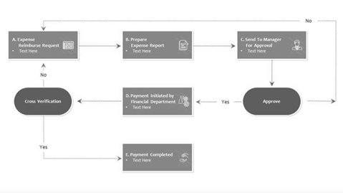
COLLABORATION
DIAGRAM
Shows how objects interact to perform the behaviour of a particular use case, or a part of a use case. First the user enters his expenses i.e A then a report is generated i.e B and the other steps follow.

Slide 14
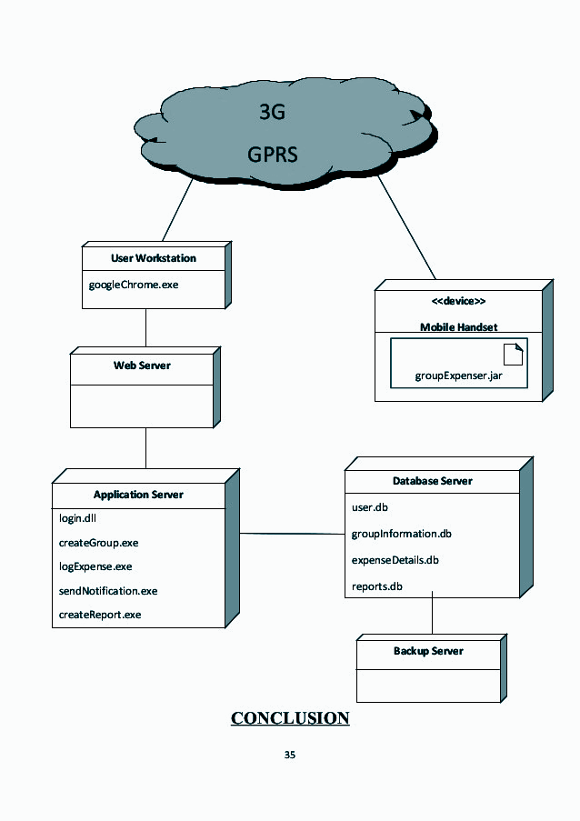
DEPLOYMENT
DIAGRAM
It shows the configuration of run time processing nodes and the components that live on them. Here the nodes are user workstation, application server, web server,mobile handset, database server and backup server.

Slide 15
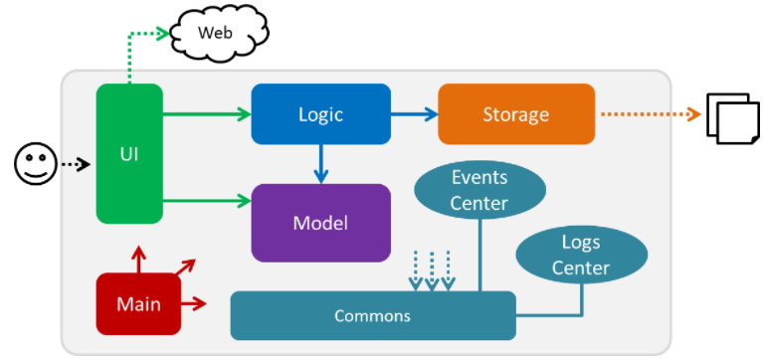
ARCHITECTURE
DIAGRAM
MAIN is responsible for:
Initializing the components in the correct sequence and connecting them up with each other when the app is launched.
Shutting down the components and invoking cleanup methods.
COMMONS represents a collection of classes used by multiple components.
LOGIC is the command executor.It defines the API.
MODEL holds the data of the app in-memory.
STORAGE reads the data from and writes data to the local data storage.

Slide 16
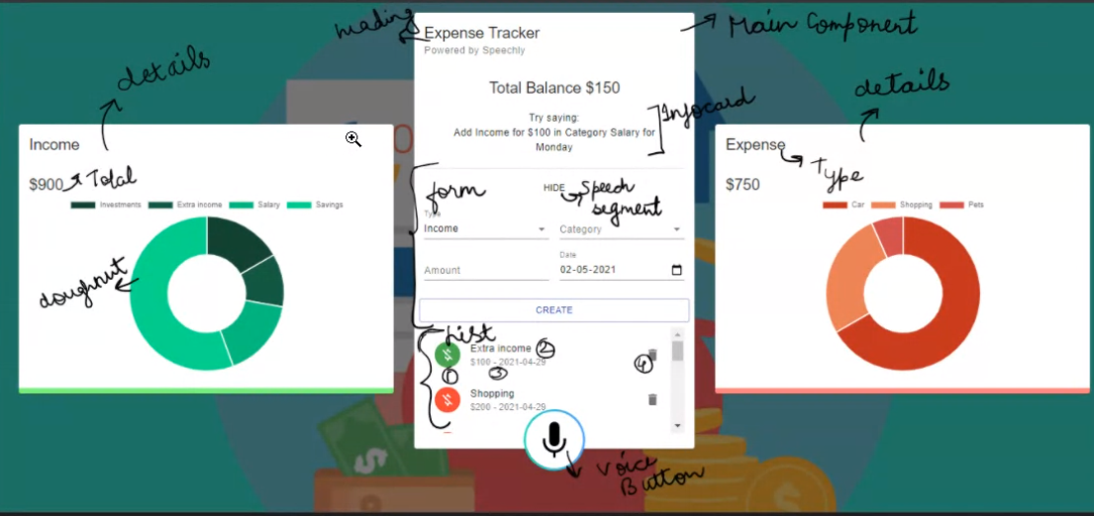
UI DESIGN

